Slide 1
The TILA/RESPA Integrated Disclosures
Getting Ready for the October 3rd Deadline
Presented by:
Morton W. Baird II
Michael Fritz Baird
Law Offices of Morton W. Baird II
242 West Sunset Ste 201
San Antonio, TX 78209
210 828 5844
www.bairdlaw.com

Slide 2
What We Will Cover
Introduction to the Consumer Financial Protection Bureau (CFPB)
Home Loan Toolkit
Loan Estimate
Closing Disclosure for Borrowers
Closing Disclosure for Sellers
Texas Disclosure
What Credit Unions Should do Now to Prepare

Slide 3

Remember the Economic Meltdown of 2008?
The greatest economic disaster since the Great Depression of the 1930s
Massive numbers of foreclosures, evictions, bank and mortgage company failures

Slide 4
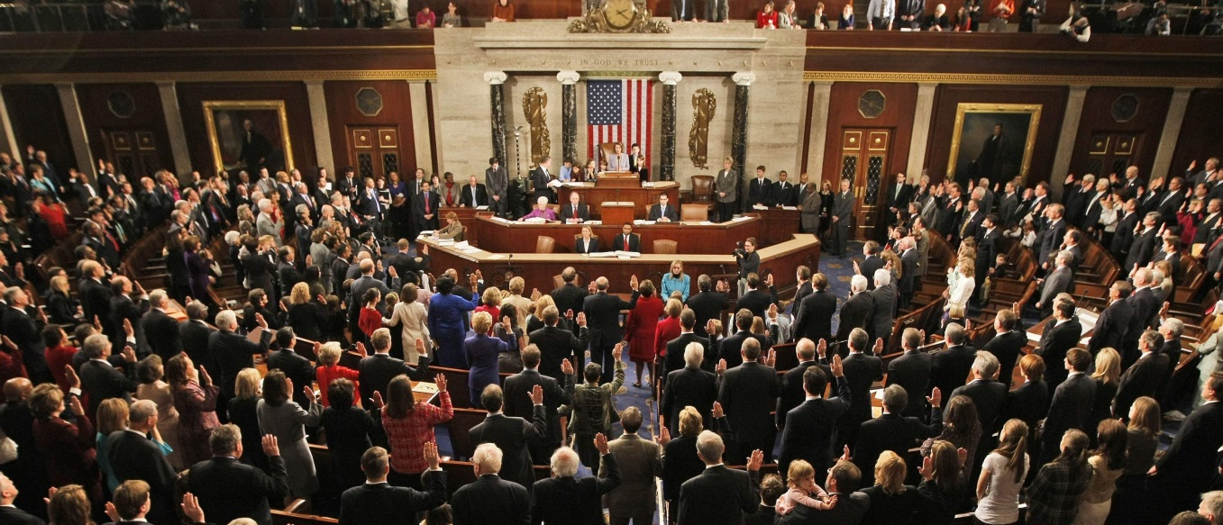
Congressional Response
Dodd Frank Act passed by Congress in 2010, signed by President Obama on July 21, 2010
The CFPB was created under Dodd-Frank and became operational in 2011.

Slide 5

What is the CFPB and What Does it Mean for Credit Unions?
CFPB= Consumer Financial Protection Bureau
CFPB website: www.consumerfinance.gov

Slide 6

Mission of the CFPB
To implement and to enforce ALL Federal consumer financial protection laws
  That means that the CFPB regulates all HOME LOANS and all of the lenders who make Home Loans
To educate and to help Consumers/Borrowers make good decisions regarding their Home Loans

Slide 7

CFPB Enforcement
CFPB has “has held bad actors accountable and helped consumers harmed by illegal practices”
  $4.6 Billion: Money ordered for consumer relief
  15 million: consumers who will receive relief because of CFPB actions

Slide 8
Bottom Line for Credit Unions
The CFPB has the Authority and Power to regulate all Home Loans
The CFPB is dedicated to helping Consumers/Borrowers

Slide 9


Slide 10

Your Home Loan Toolkit
A Step-by-Step Guide
Required for purchase transactions
Useful for any type of home loan
Helps borrower determine the appropriate loan

Slide 11

Introduction to the TRID Disclosures
4 forms become 2
TILA and RESPA combined
Applies to most closed-end consumer credit transactions secured by real property
  Includes Lot loans, Home Equity, Home Improvement, Refinance, Purchase
  Excludes HELOCs, Reverse Mortgages, and loans secured by mobile home

Slide 12
Effective Date
Effective for applications received on or after October 3, 2015
Lenders may not use the new forms early
The GFE, HUD-1, and Truth-in-Lending forms must be used until new disclosures are required

Slide 13

Fee & Document Restriction
No fees or verification documents until Applicant receives Loan Estimate and indicates “Intent to Proceed”
  Exception: Upfront “bona fide” and “reasonable” fee for obtaining credit report
  Exception: For Pre-approval, Applicant may voluntarily submit verification documents

Slide 14

Optional Cost Estimate
Lenders may provide an optional “Cost Estimate” to consumers before they apply for a loan
The Cost Estimate MAY NOT resemble the Loan Estimate
The Cost Estimate must contain the following disclaimer:

Slide 15
What is an Application?
Application:
  Name
  Income
  Social Security Number
  Property Address
  Estimated value of property
  Mortgage loan amount sought
New definition eliminates “catch-all” component of application

Slide 16

Loan Estimate
Applications received on or after October 3, 2015
Combines the Initial TIL and GFE
Delivered or placed in the mail within 3 business days of “Application”
Contains a good faith estimate of costs of loan and transaction terms

Slide 17
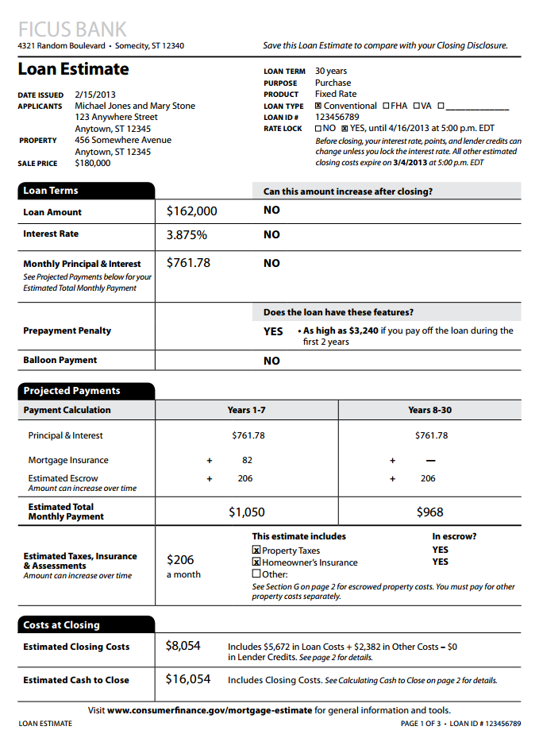
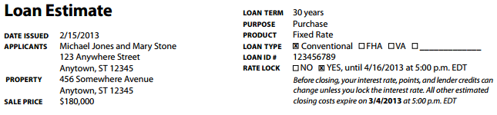
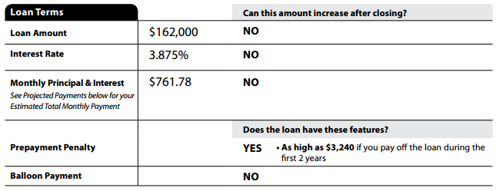
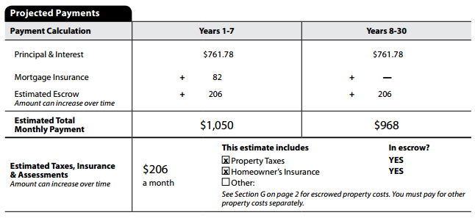
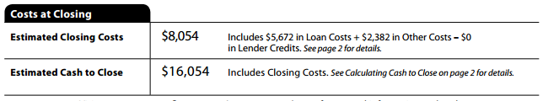

Slide 18
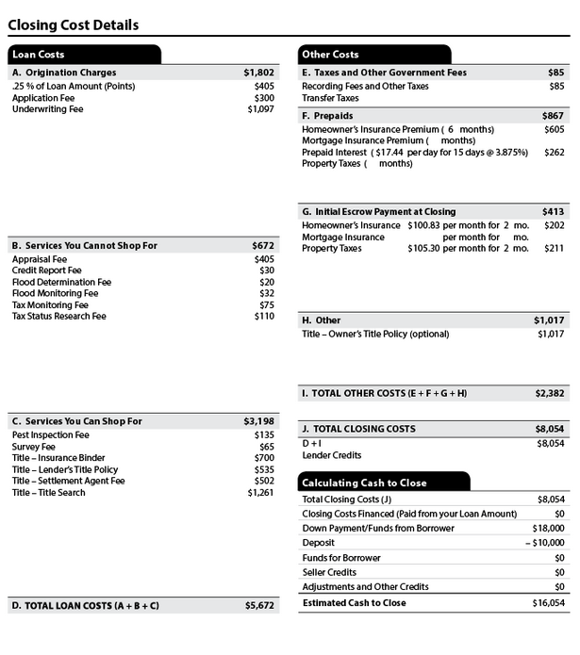

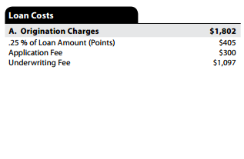
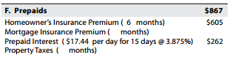
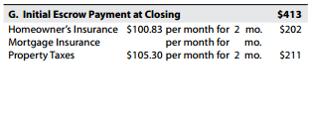
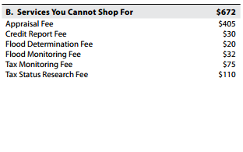
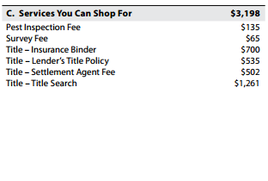

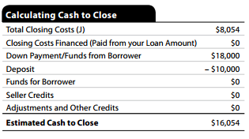

Slide 19
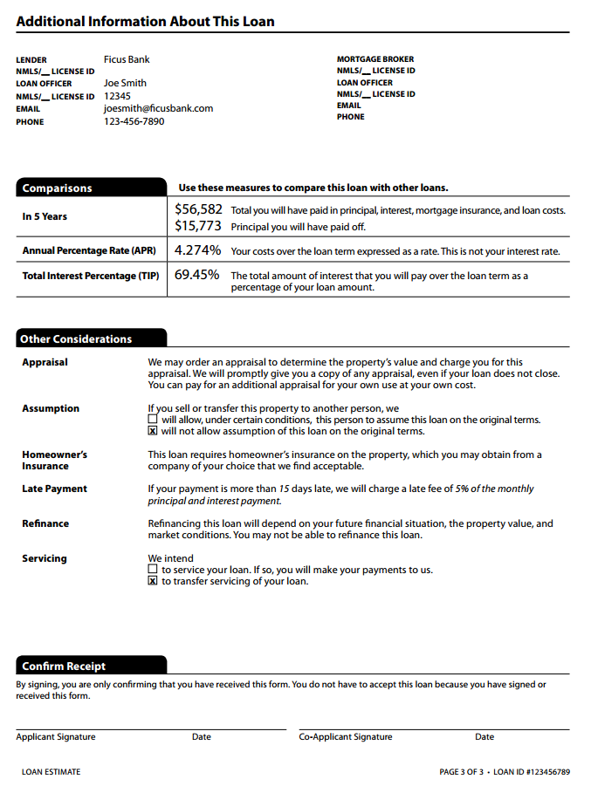
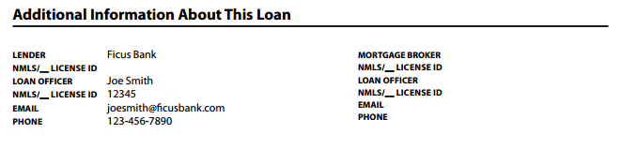
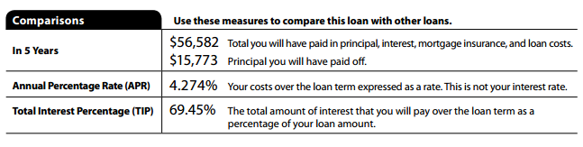
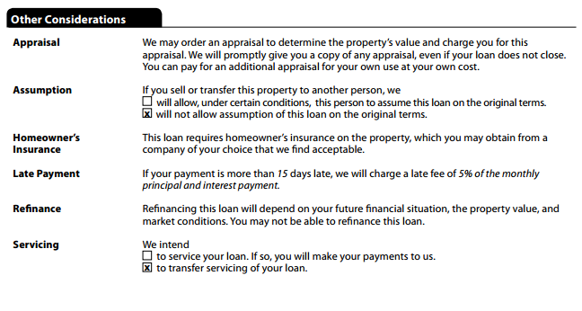
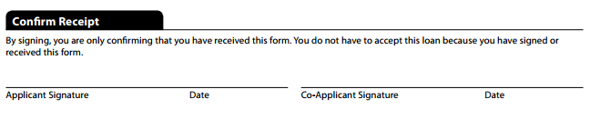

Slide 20

Delivery of Loan Estimate
Delivered or placed in the mail no later than 3 business days after application
“Business Day” for the Loan Estimate means a day on which the creditor’s offices are open to the public for carrying out substantially all of its business functions.

Slide 21
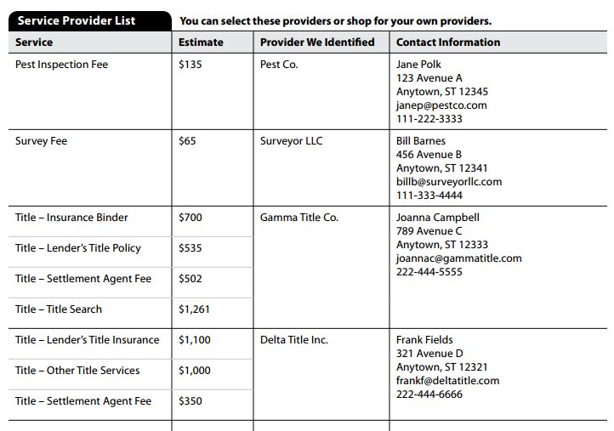
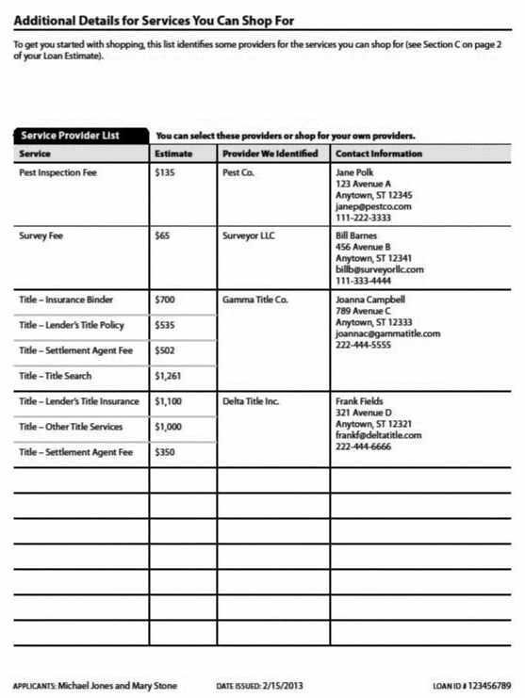
Written List of Service Providers
Provided as attachment to Loan Estimate if consumer is permitted to shop
List should include at least one provider for each service

Slide 22
Tolerances
There are three categories of fees:
  Fees that cannot change
    Fees paid to Lender or its affiliates
    Third Party fees that the borrower cannot shop for
  Fees that cannot increase more than 10%
    Recording Fees
    Fees paid to Third Parties chosen by consumer from the Written List of Service Providers
  Fees that may change any amount
    Prepaid interest, property insurance premiums, amounts placed into escrow
    Fees for which the consumer can shop and they select provider NOT on Written List of Service Providers
    Fees paid for services not required by lender

Slide 23
Revisions to Loan Estimate
Lenders may only reissue Loan Estimate when there is a Changed Circumstance:
  Extraordinary event
  Inaccurate information provided by applicant
  Change to terms of loan requested by borrower
  Borrowers notifies lender of their Intent to Proceed more than 10 days after Loan Estimate delivered

Slide 24

Examples of Changed Circumstances
Borrower makes less income than stated in application
Loan applicant becomes unemployed
Lender learns about pending lawsuit involving property
Lenders must DOCUMENT any the cause of any revised Loan Estimates

Slide 25
Timing of Revised Loan Estimate
The Revised Loan Estimate - delivered or placed in the mail no later than three business days after the lender receives the new information

Slide 26

Intent to Proceed
Applicant must indicate an “Intent to Proceed” within 10 days of receiving Loan Estimate
Can be written or verbal
Lender may require written or verbal “Intent to Proceed”
Lender must document
No fees, except credit report fee, until borrower has given “Intent to Proceed”

Slide 27
Closing Disclosure
Effective for applications received on or after October 3, 2015
Combines Final TIL statement and HUD-1
Must be received by Buyer at least 3 business days before closing
Contains the actual terms and costs of the transaction

Slide 28
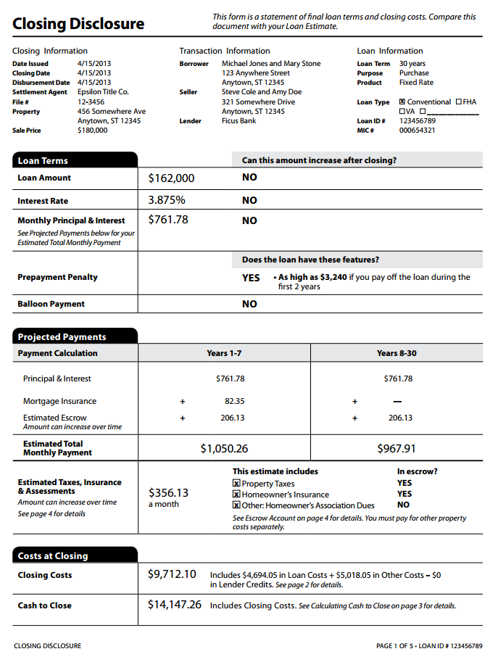
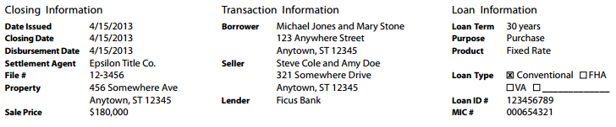
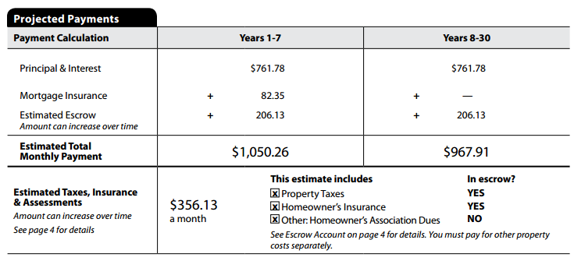
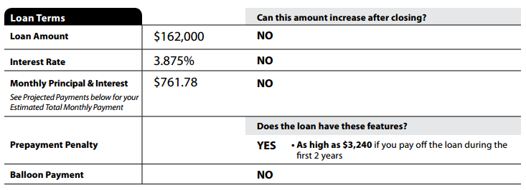
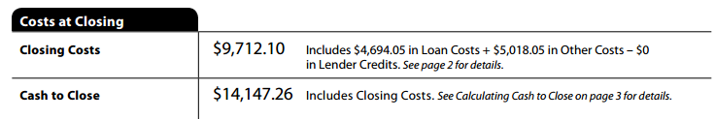
Closing Disclosure
Page 1

Slide 29
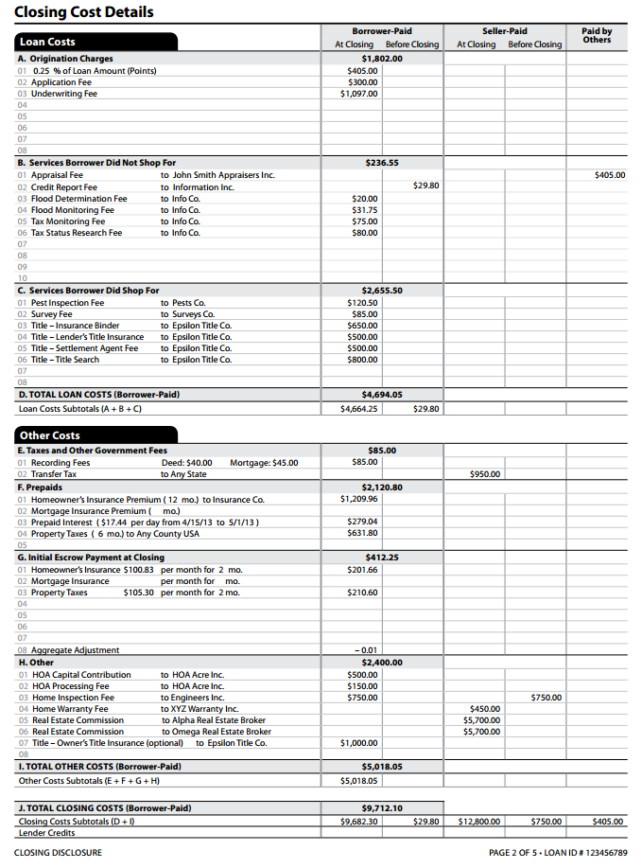
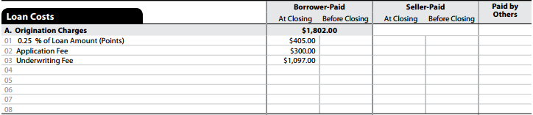
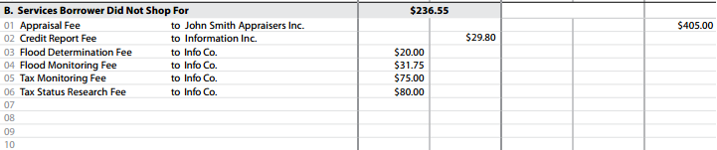
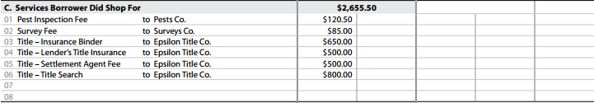

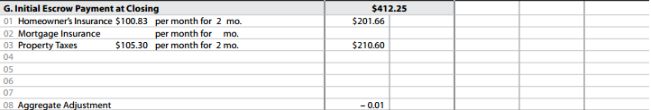
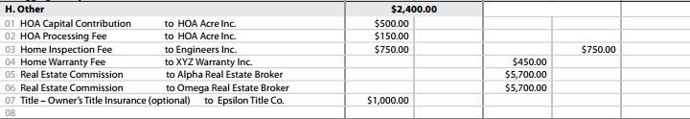
Closing Disclosure
Page 2

Slide 30
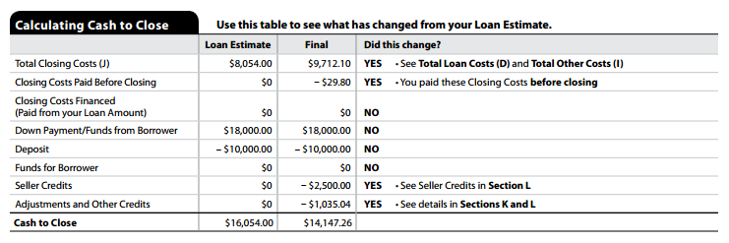
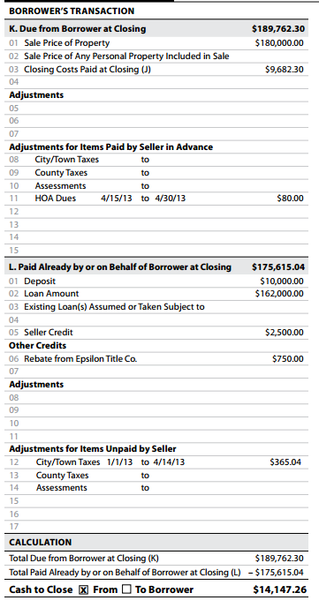
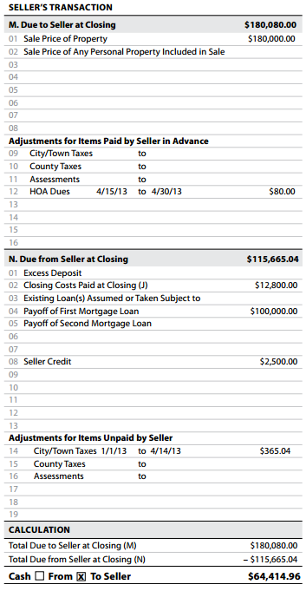
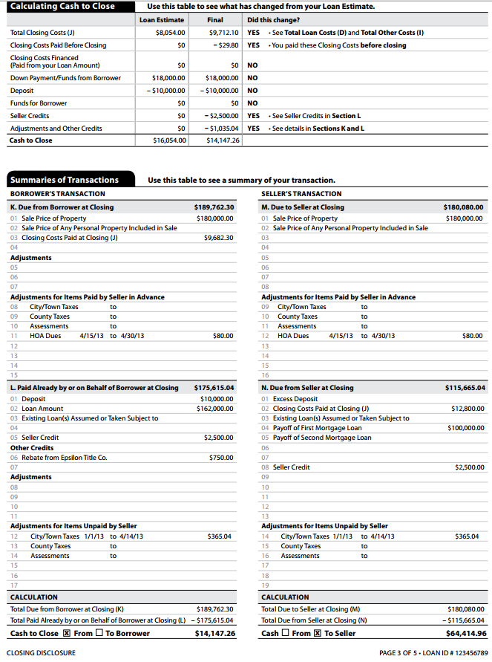
Closing Disclosure
Page 3

Slide 31
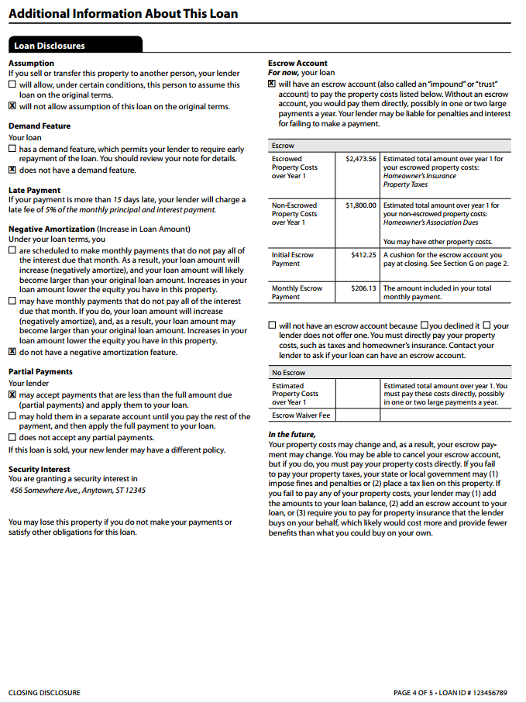
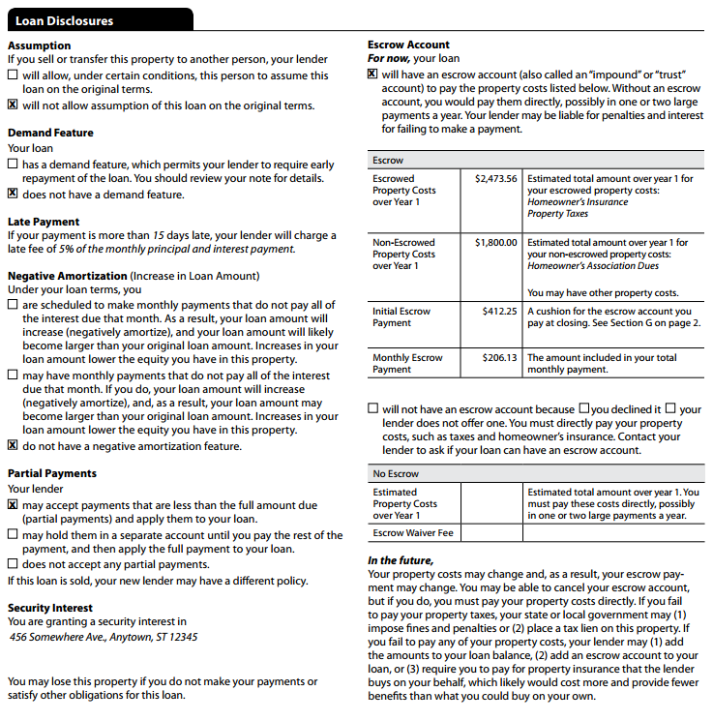
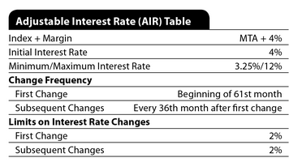
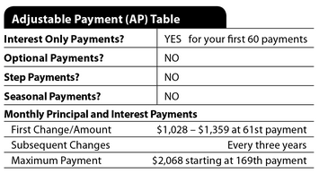
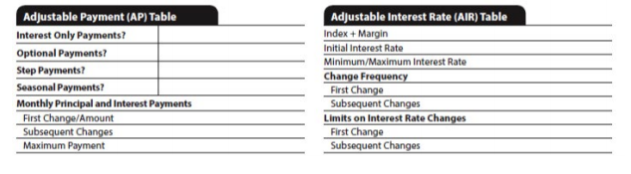
Closing Disclosure
Page 4

Slide 32
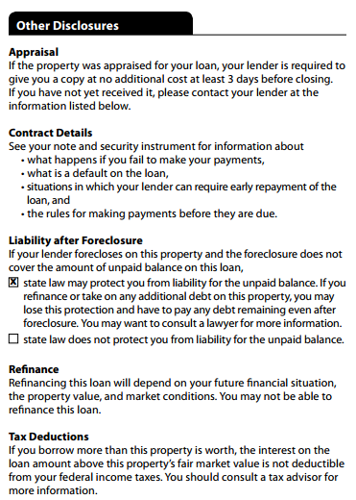
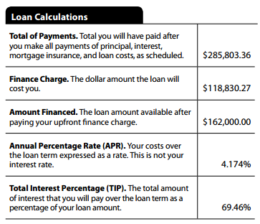
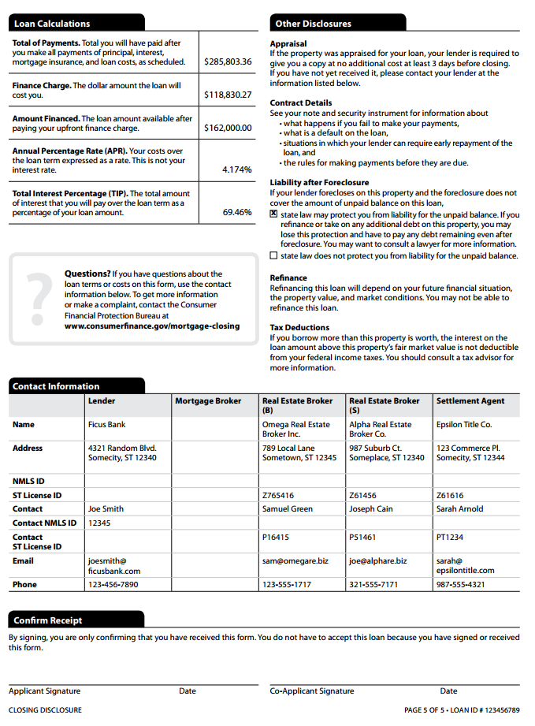
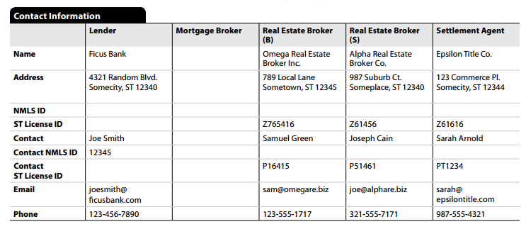
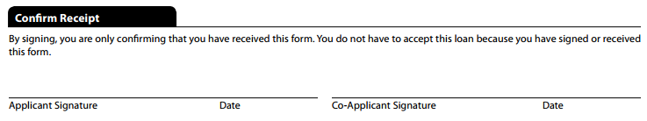
Closing Disclosure
Page 5

Slide 33
When Does The Closing Disclosure Need To Be Delivered to the Borrower?

Slide 34
Delivering the Closing Disclosure
Borrower must receive Closing Disclosure at least 3 business days before closing
If mailed or e-mailed, presumed to be received by Borrower 3 business days after put into mail or e-mailed (mail/e-mail 7 days before closing)
“Business Day” is all days except Sundays and Federal holidays
Borrower may only waive the 3 day waiting period for a “bona fide personal financial emergency”

Slide 35
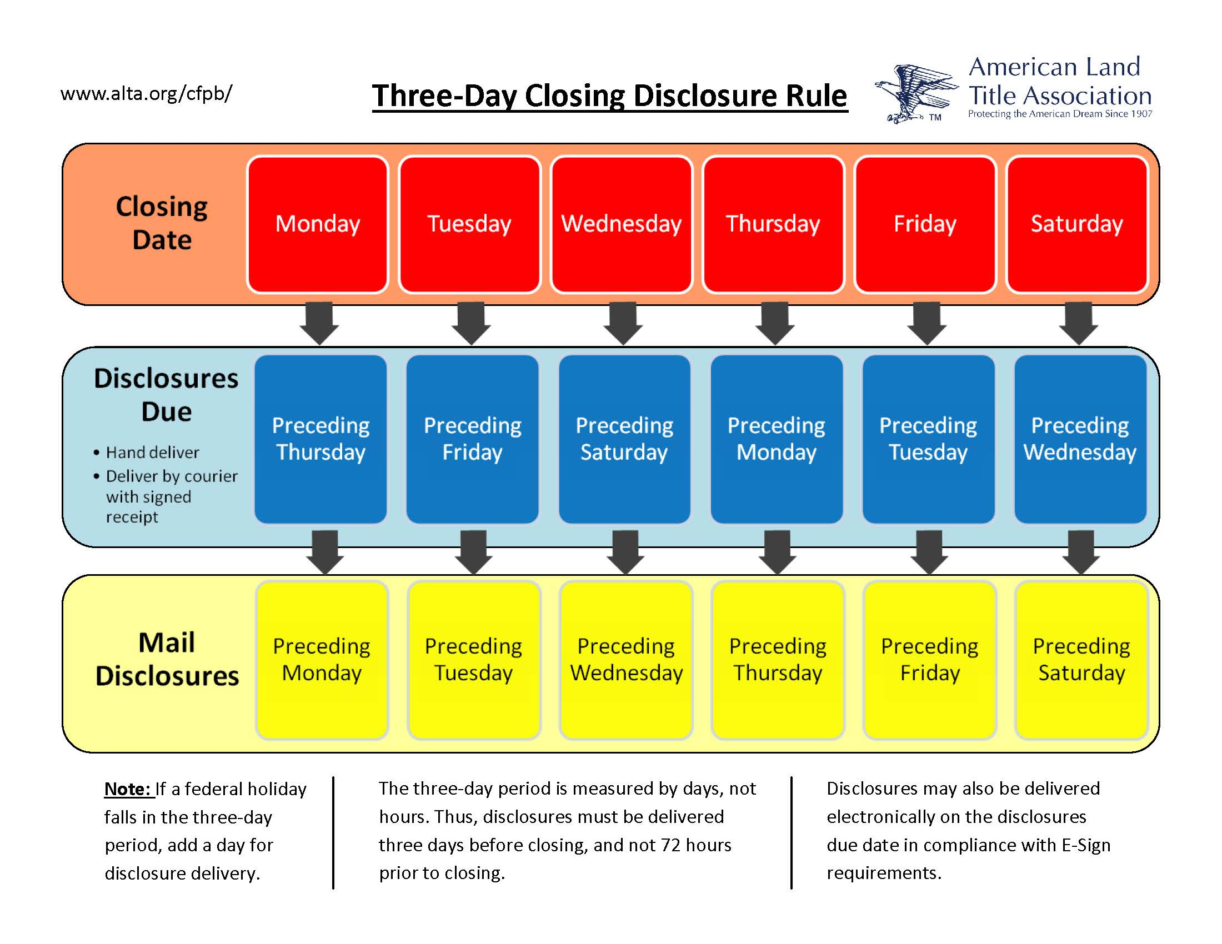

Slide 36
Providing Revised Closing Disclosure Before Closing
New three day waiting period only for the following:
  APR increases more than 1/8 of 1%
  Prepayment penalty added
  Change loan type
No New three day waiting period for any other change prior to closing
  Lender may provide revised Closing Disclosure at closing

Slide 37
Seller’s Closing Disclosure
Provided to Seller day of closing
Seller may request to see Seller’s Closing Disclosure one day prior to closing
Title Company responsible for preparation
Title Company must deliver to Seller and to Lender

Slide 38
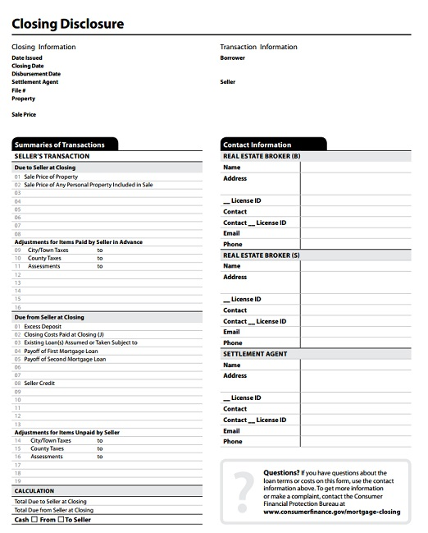

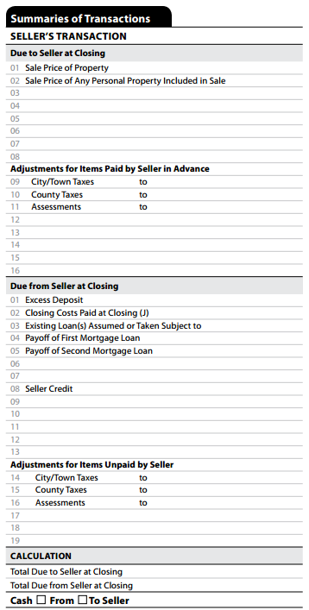
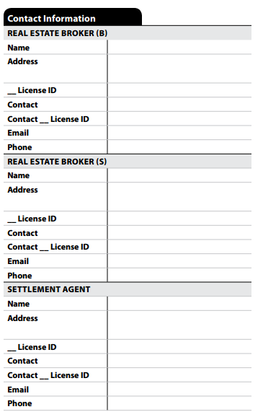
Seller’s Closing Disclosure
Page 1

Slide 39
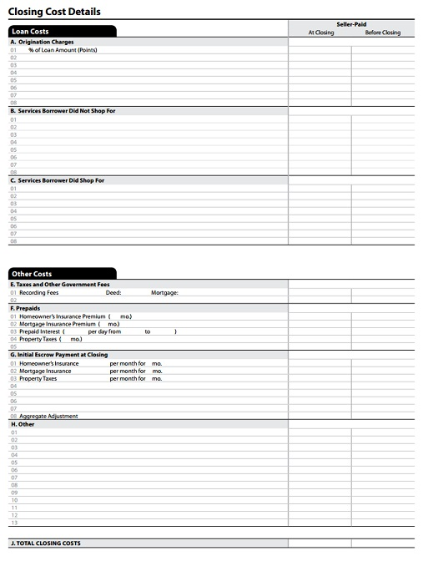


Seller’s Closing Disclosure
Page 2

Slide 40
Proposed Texas Disclosure Form
Title Company to prepare Texas Disclosure
Serves as acknowledgement and authorization for disbursement
Proposed Form has been published by Texas Department of Insurance
Why is there a new Texas Disclosure form?
  The Federal forms do not satisfy Texas Title Insurance requirements

Slide 41


Proposed Texas Disclosure Form

Slide 42


Slide 43


Slide 44
Top 5 Things Lenders Should Do Now to be Prepared

Slide 45

1. Figure out Your Implementation Process for the New Disclosures
Are you set up to handle the Loan Estimate?
Are you set up to handle the Closing Disclosure?

Slide 46

2. Select Your Technology Providers
Select your technology providers NOW
Have a candid discussion with your technology provider
  Will they be ready?
  Set up specific dates for training your staff

Slide 47

3. Allow Sufficient Time for Testing
Lenders should allot sufficient time to test the new systems

Slide 48

4. Educate the Key Players
Educate Staff
Educate Realtors
Educate Borrowers
Educate Service Providers

Slide 49

5. Have a Candid Discussion with Title Companies
Is the Title Company prepared for the new disclosures?
What will be the role of the Title Company in the closing?

Slide 50
QUESTIONS?

